Slide 1

AIRLINE PASSENGER SATISFACTION
SUBMITTED BY:
PON SWARNALAYA RAVICHANDRAN

Slide 2

TABLE OF CONTENTS
Introduction
Dataset description
Data preprocessing
Application layout
Outlier detection
Principal Component Analysis
Normality test
Heatmap & scatter matrix
Statistics
Data visualization

Slide 3

INTRODUCTION
Airline passenger satisfaction analysis completely focuses on the satisfaction of the passenger who travel for either personal reason or business reason.
The satisfaction analysis is done by taking the various features of the column against the axis.
It is a collection of data that provides insight into the experiences of airline passengers and their satisfaction levels

Slide 4
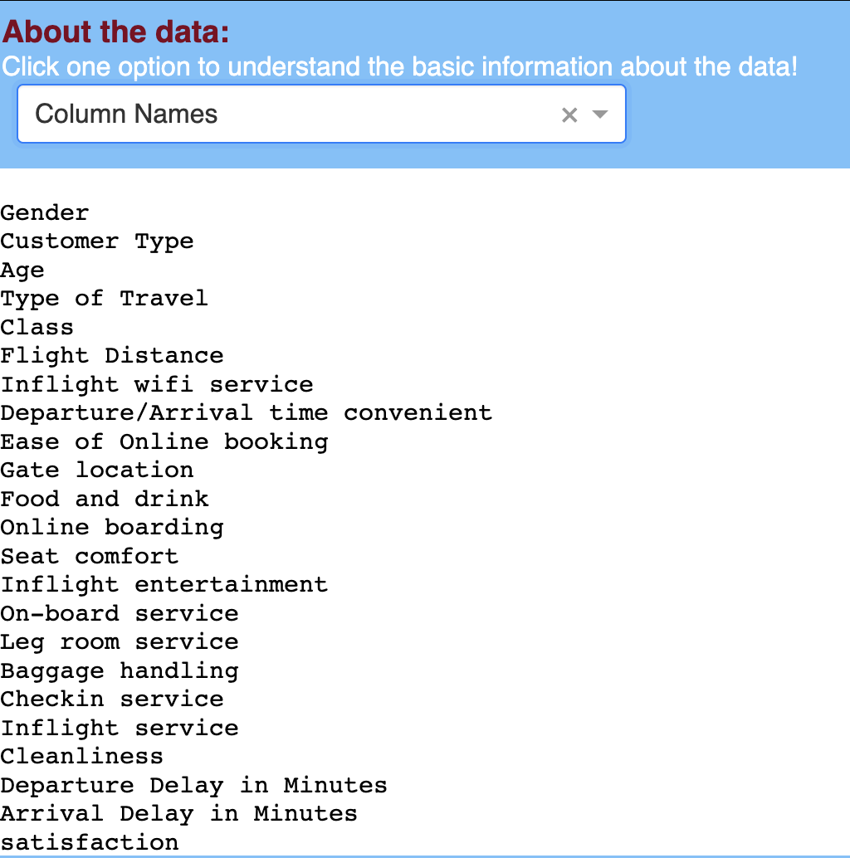
DATASET DESCRIPTION
The data was collected by surveying passengers who had recently traveled on a major airline, and it includes information about their demographics, flight information, and overall satisfaction with their experience.
The dataset contains 129,880 rows and 24 columns.
Data source: KAGGLE
LINK: Click here

Slide 5
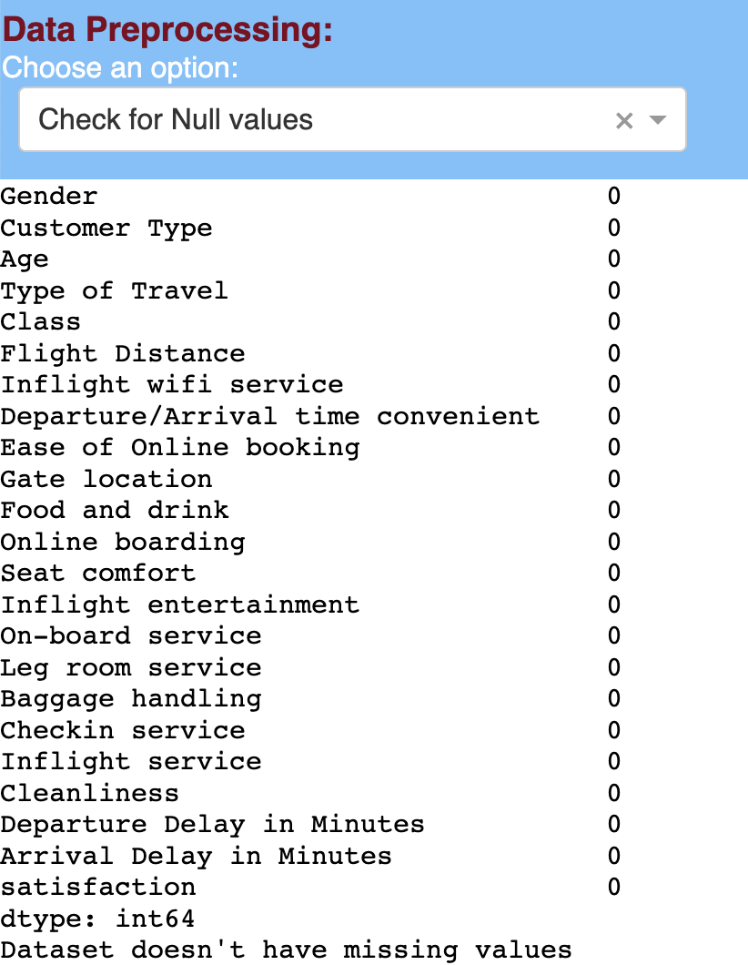
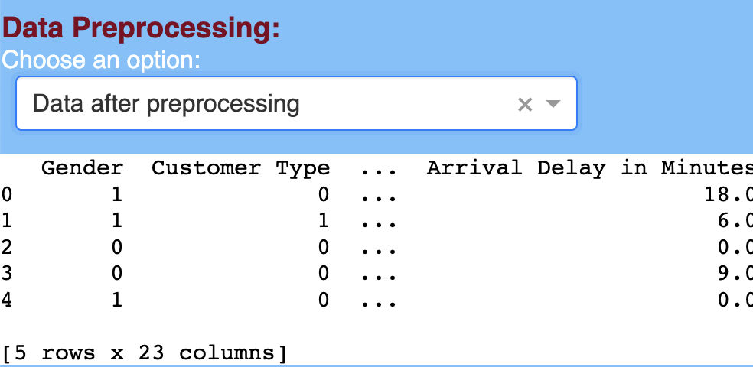
DATA PREPROCESSING
The data is processed for further operations.
It is checked for missing values, duplicates and NaN values.
The missing values are cleaned.
Then the data is set for future analysis

Slide 6
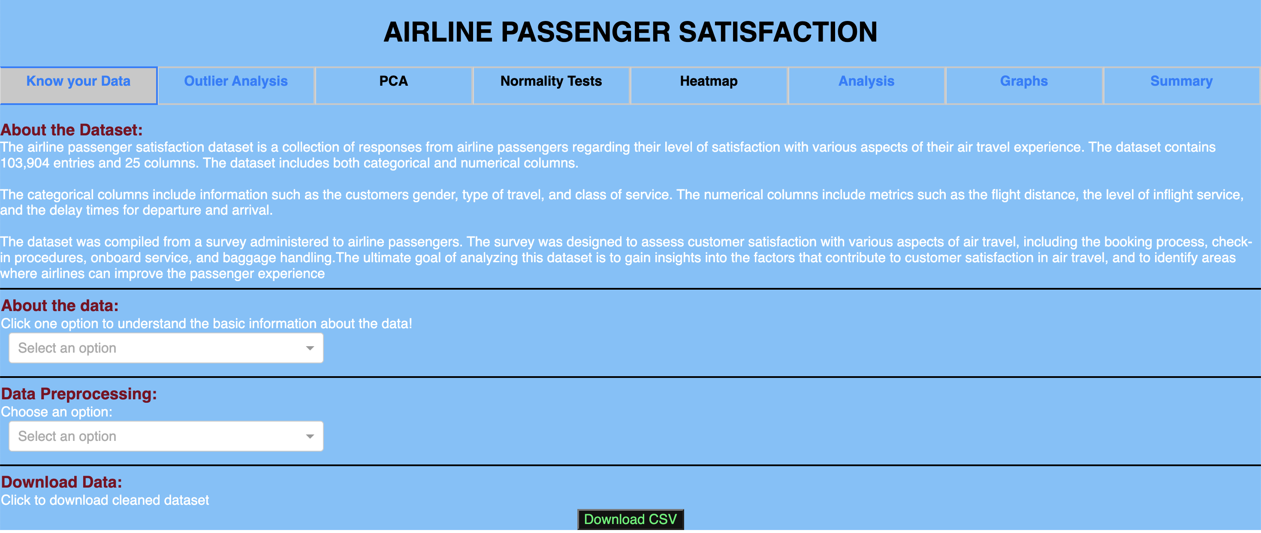
APPLICATION LAYOUT
1.Heading
2. Multiple tabs
3. Multiple divisions
4. Download

Slide 7
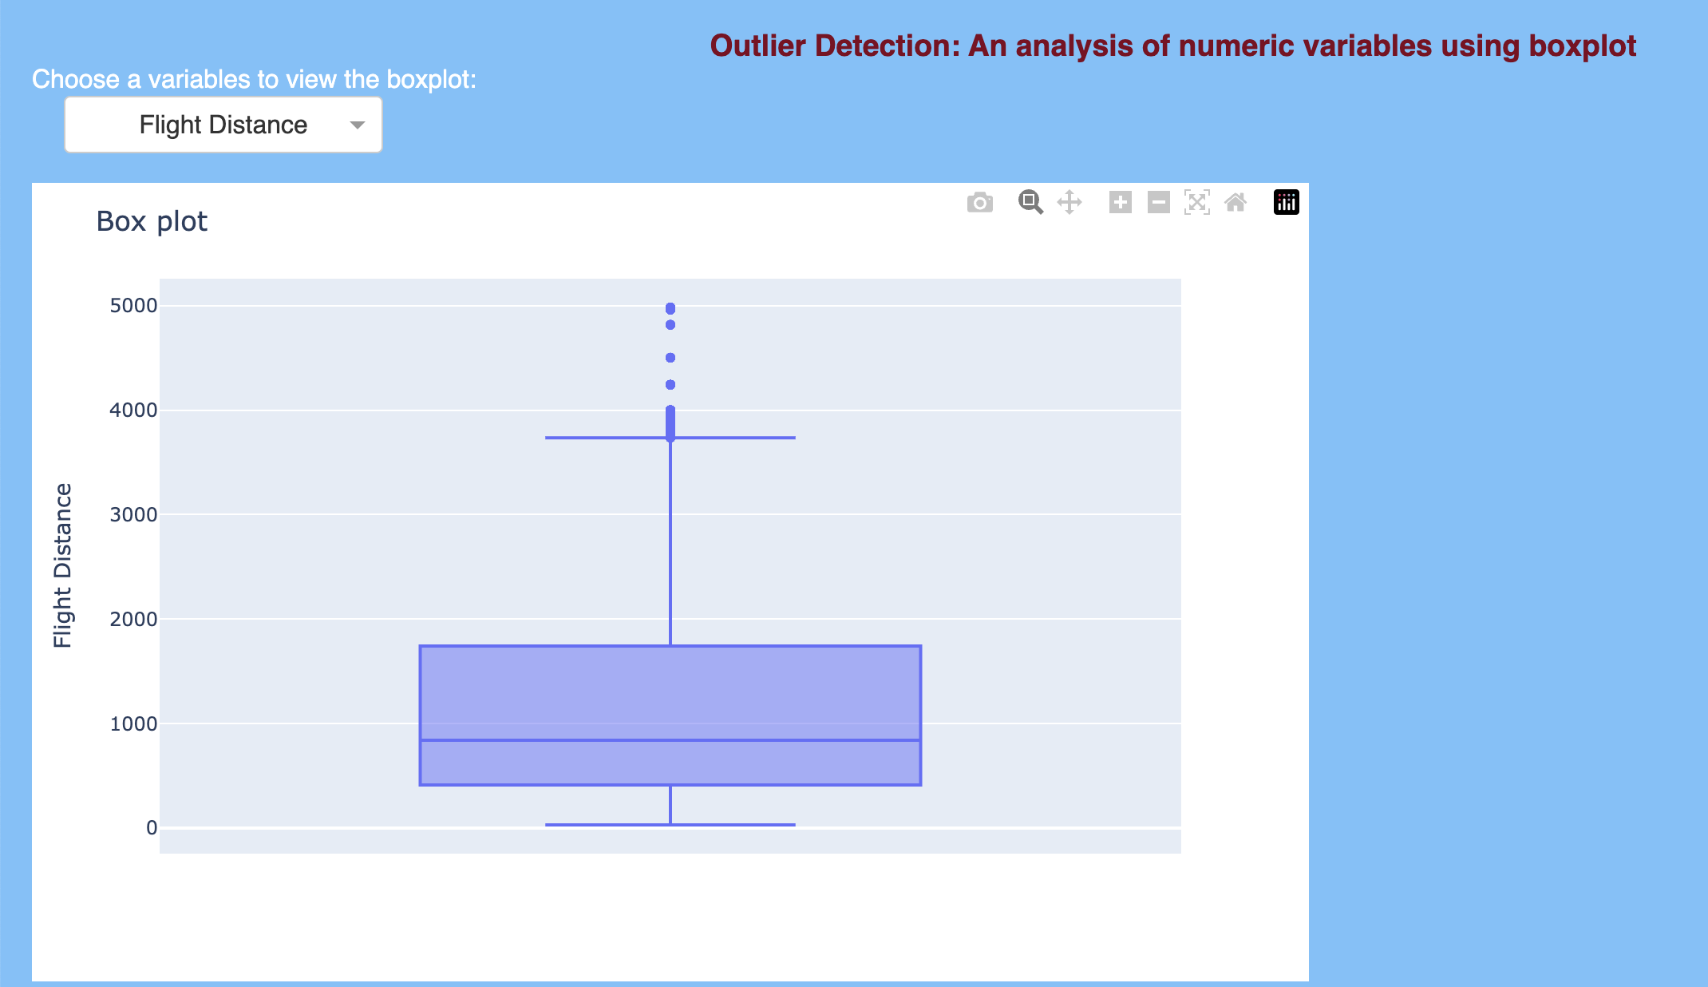
OUTLIER DETECTION
Box plots are typically used to detect the outliers in the data.
The presence of outliers can indicate issues such as measurement errors, data entry errors, or unusual data points that need to be investigated further.

Slide 8
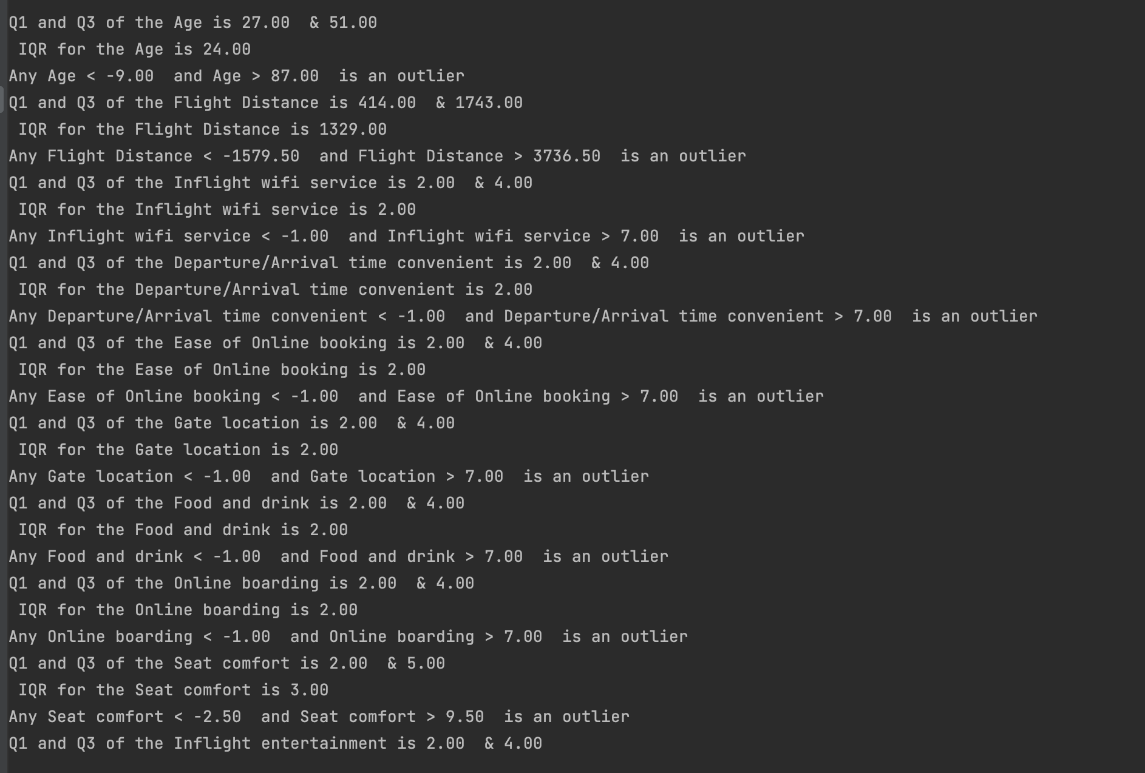
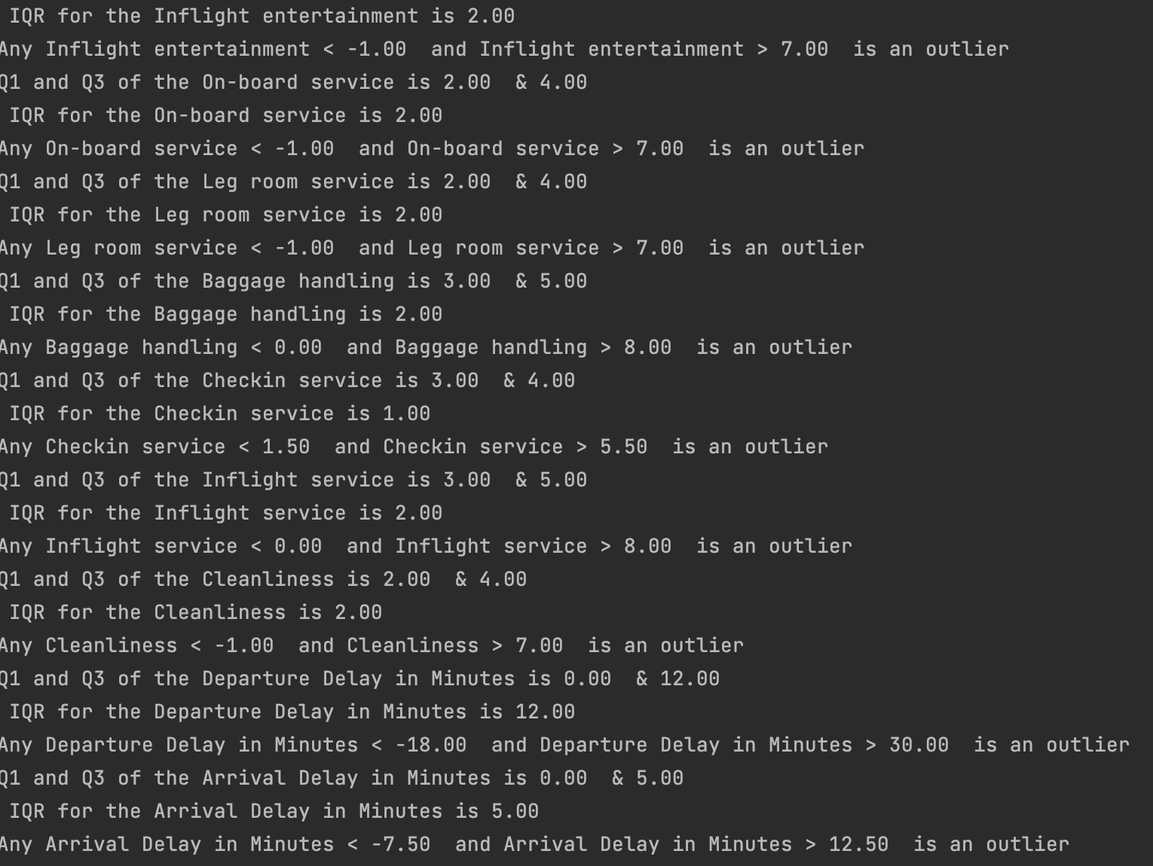
IQR OUTPUTS

Slide 9
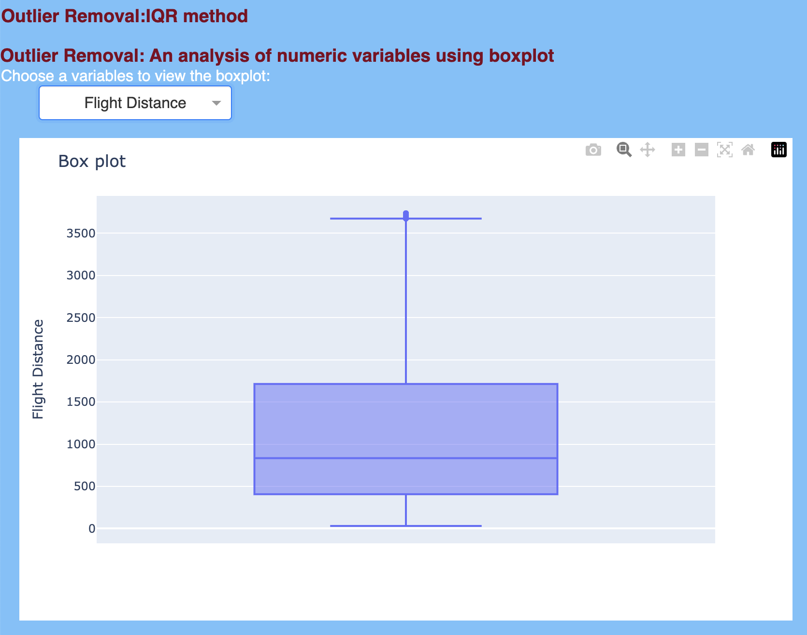
AFTER OUTLIER REMOVAL

Slide 10
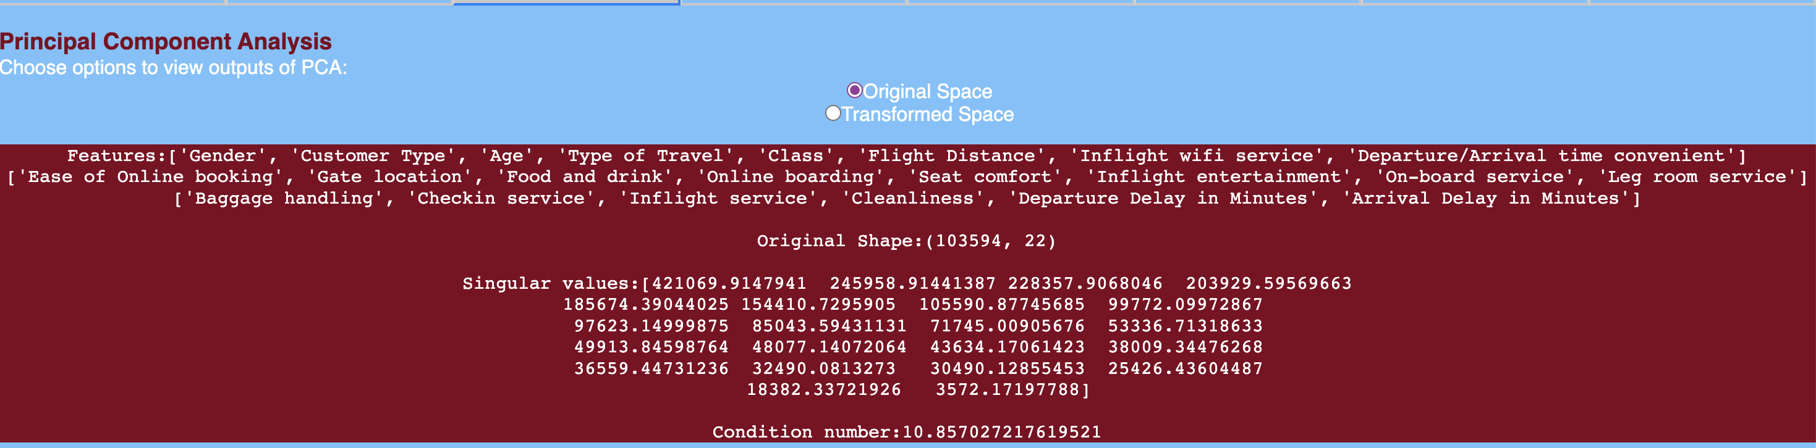

PRINCIPAL COMPONENT ANALYSIS

Slide 11
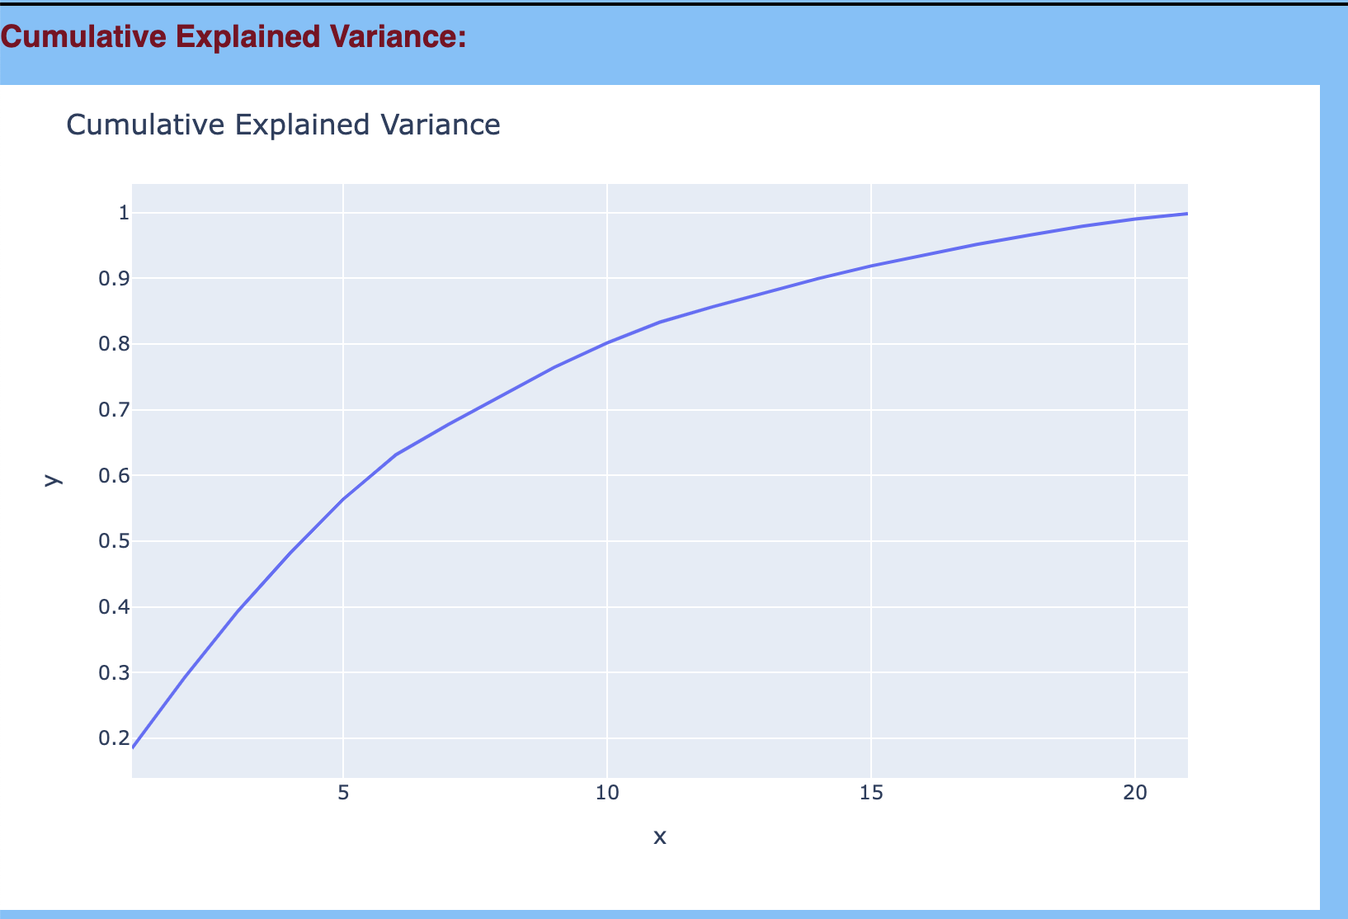
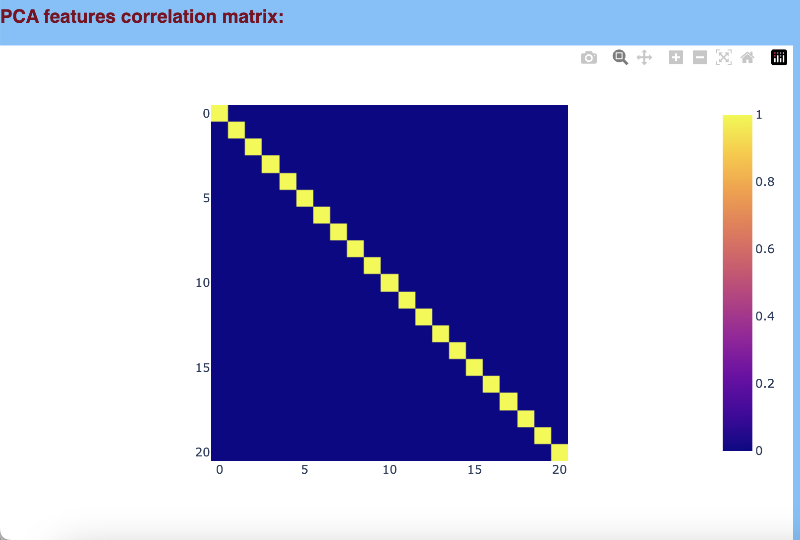
PCA
PCA is a linear transformation technique, which is useful for reducing the dimensionality of large datasets, which can be computationally expensive to analyze
By reducing the number of variables, PCA can simplify the analysis and improve the interpretability of the results.

Slide 12
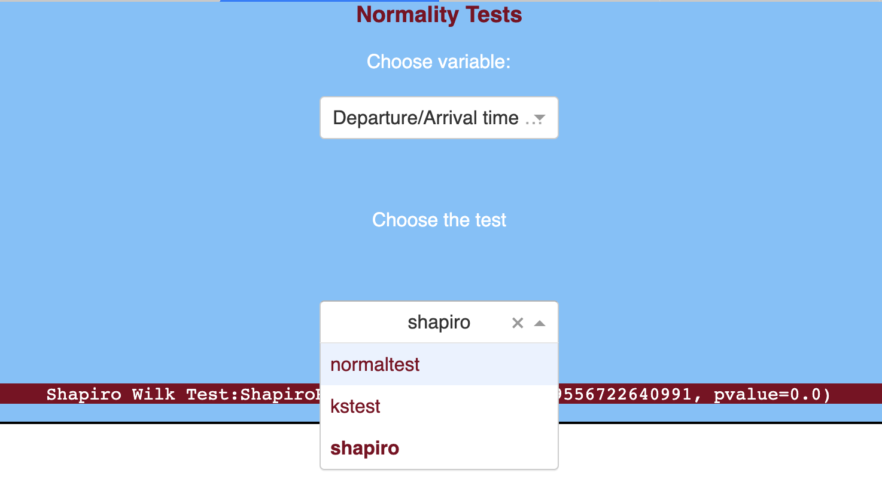
NORMALITY TESTS
The vital role of normality test is to find if the data is normally distributed or not.
If the p-value obtained from the test is less than the significance level, typically 0.05, then the null hypothesis is rejected, indicating that the data does not follow a normal distribution.

Slide 13
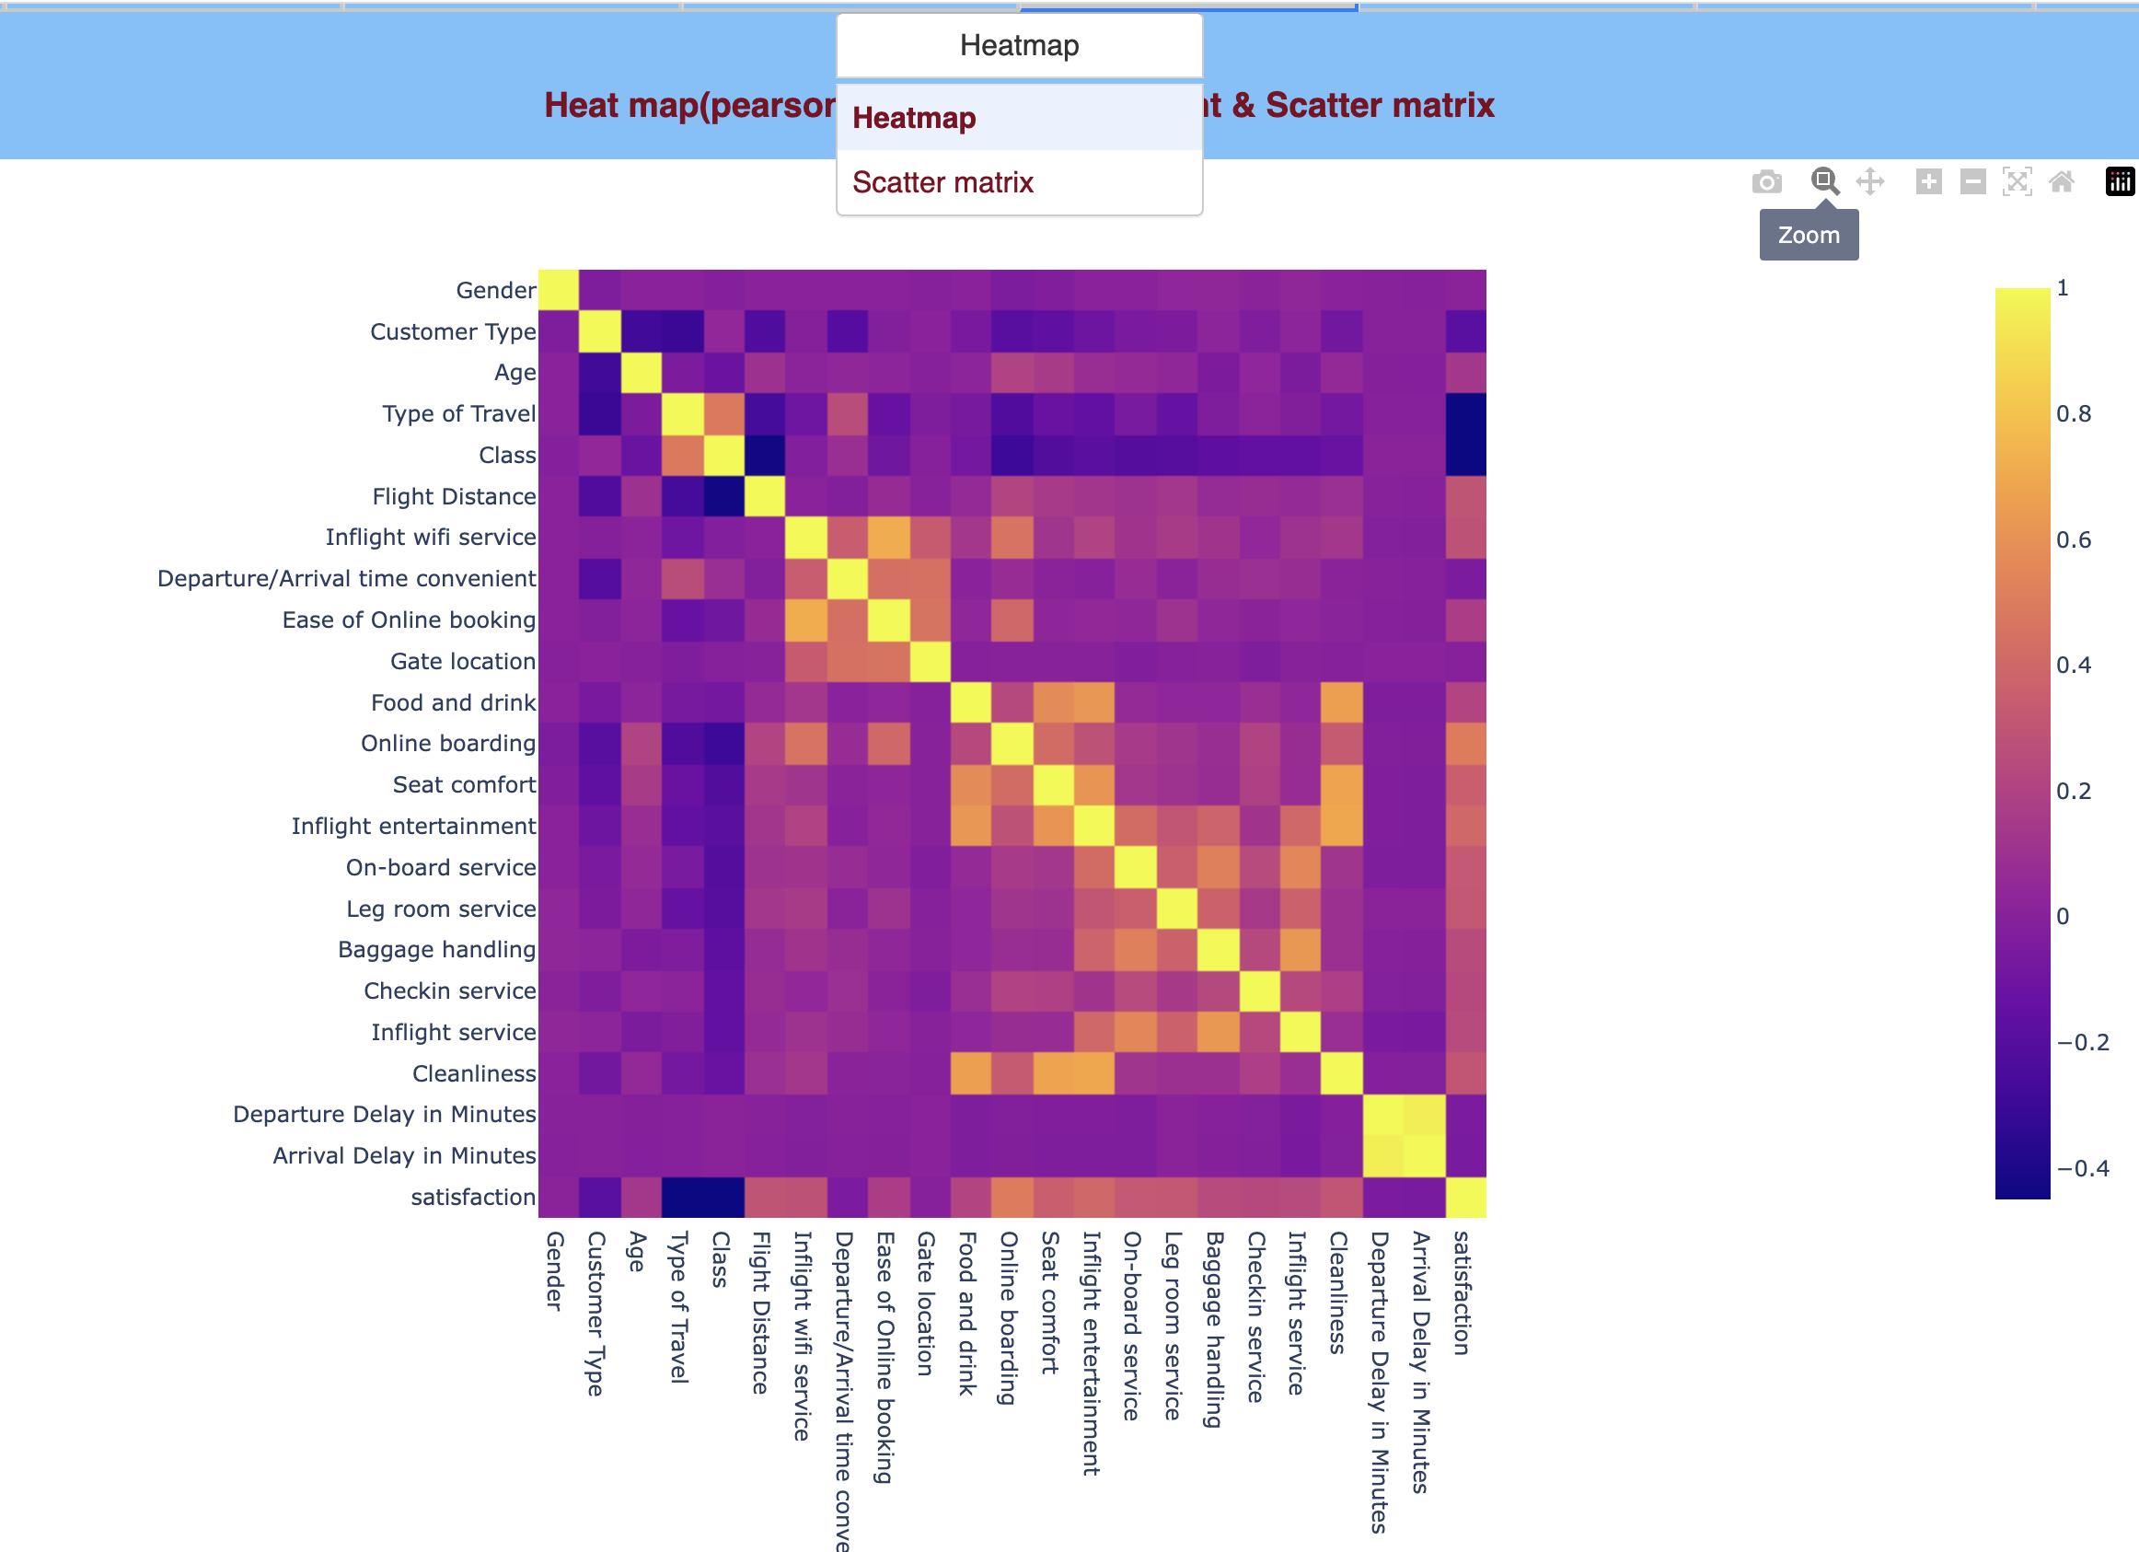
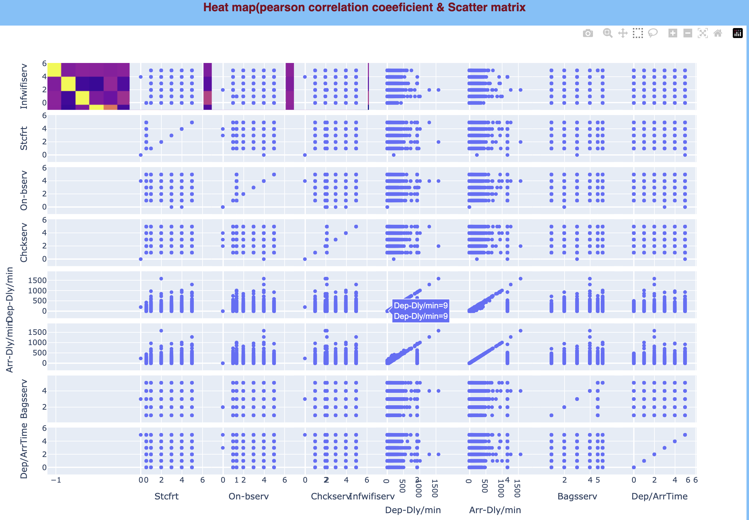
HEATMAP & SCATTER

Slide 14
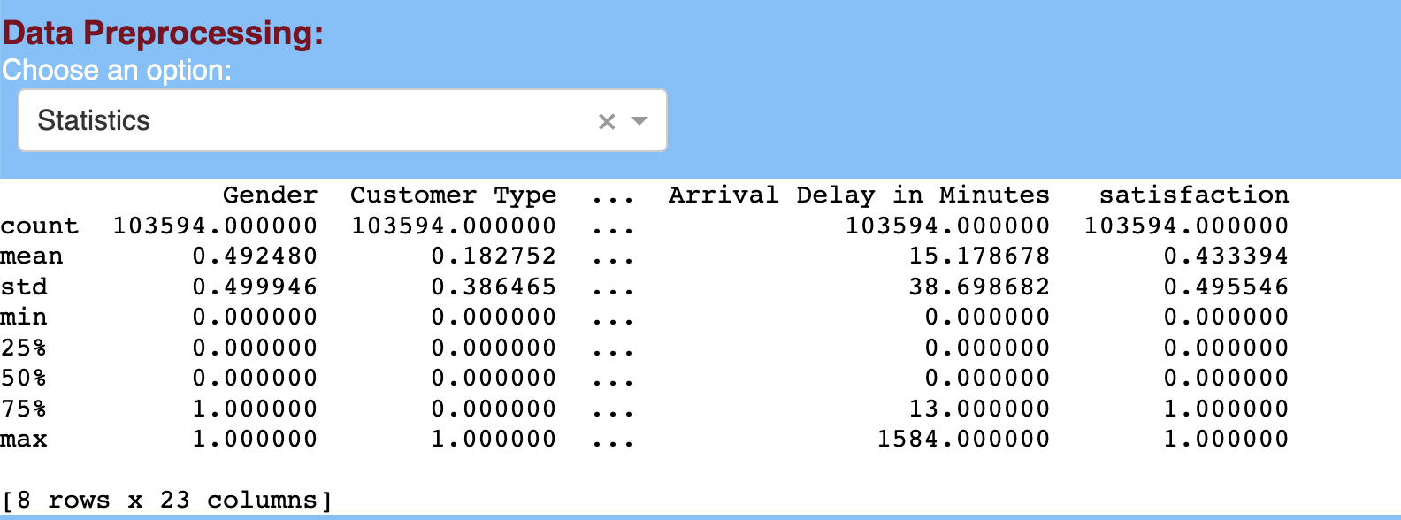
STATISTICS

Slide 15

DATA VIZUALIZATION

Slide 16
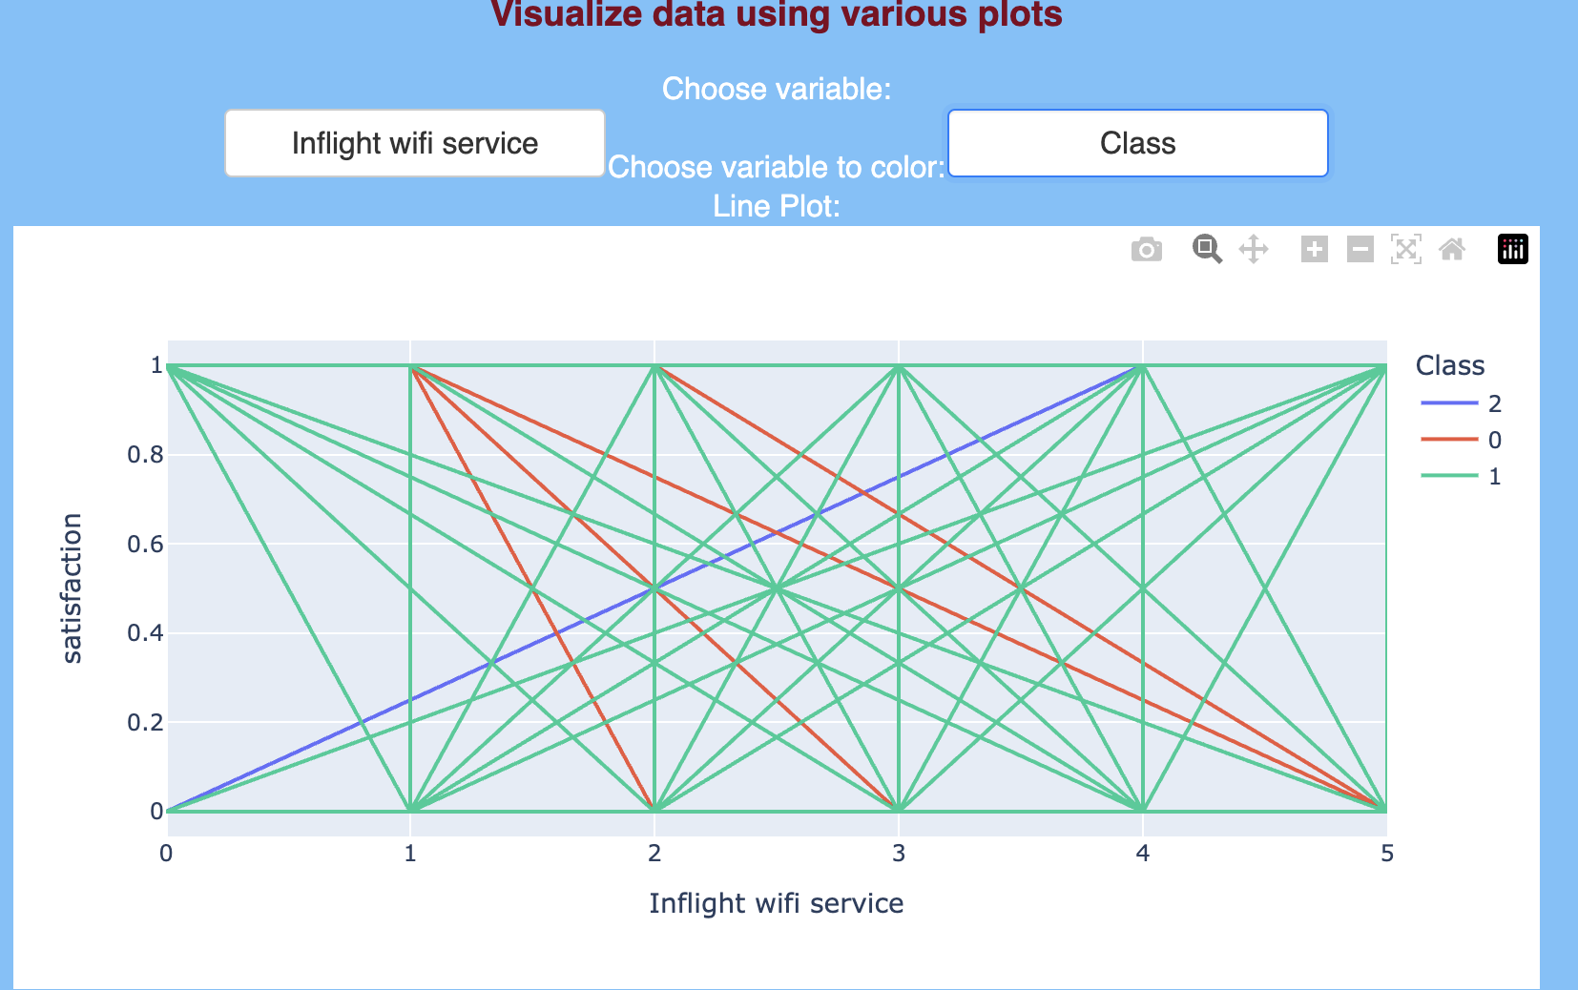
LINE PLOT

Slide 17
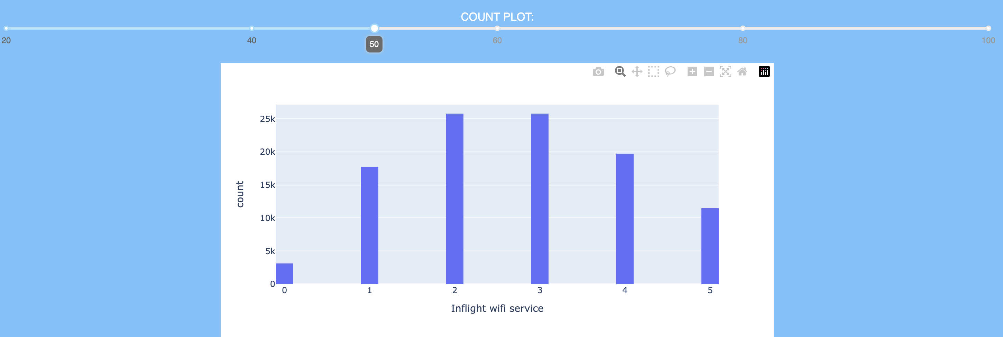
COUNT PLOT

Slide 18
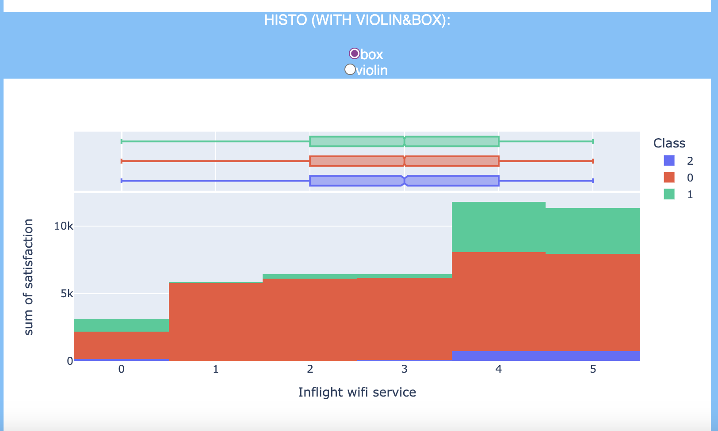
HISTOGRAM
BOX
VIOLIN

Slide 19
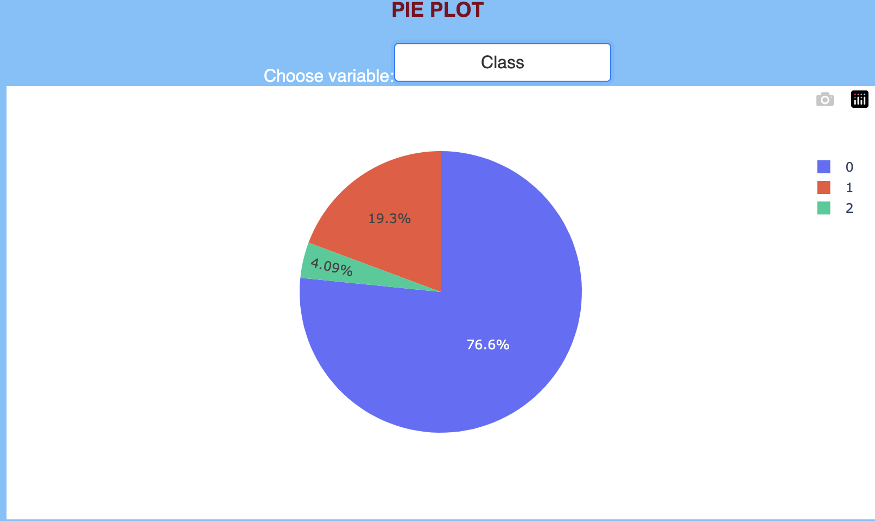
PIE PLOT

Slide 20
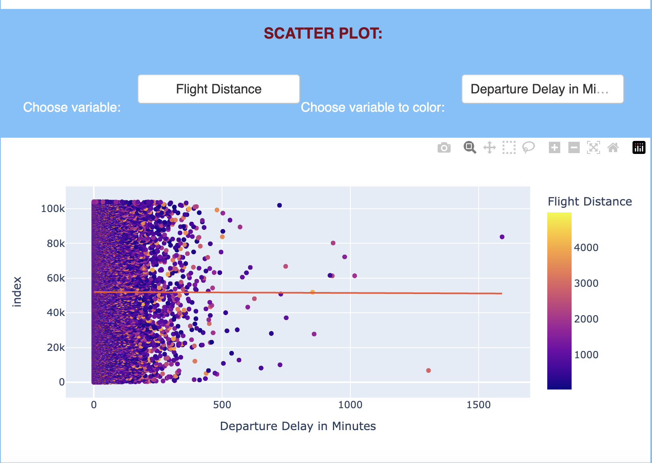
SCATTER PLOT

Slide 21
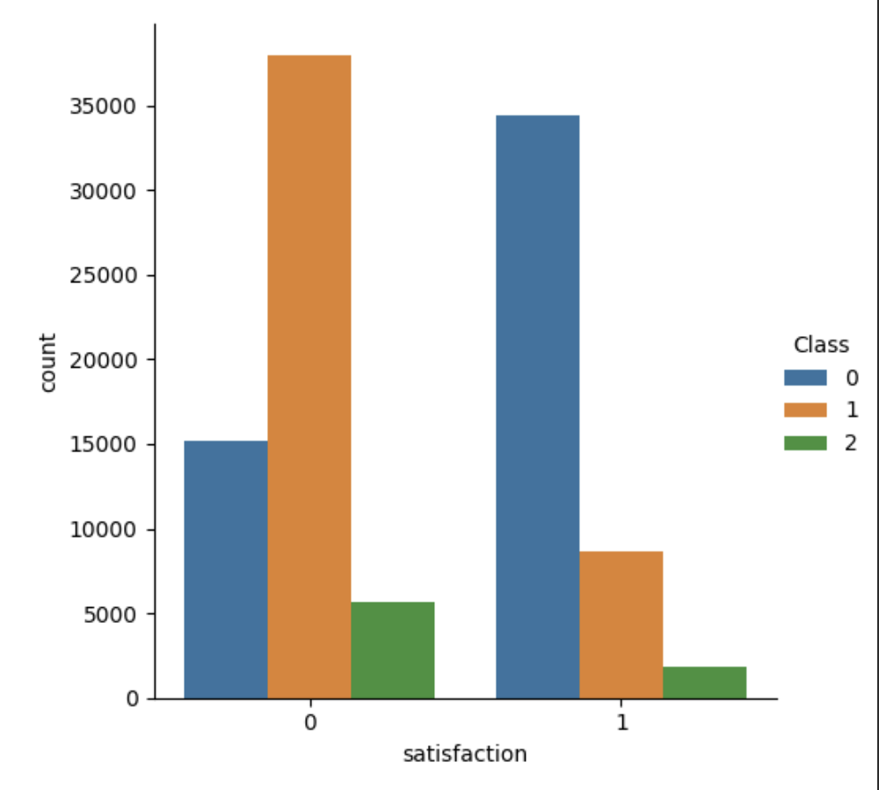
CAT PLOT

Slide 22
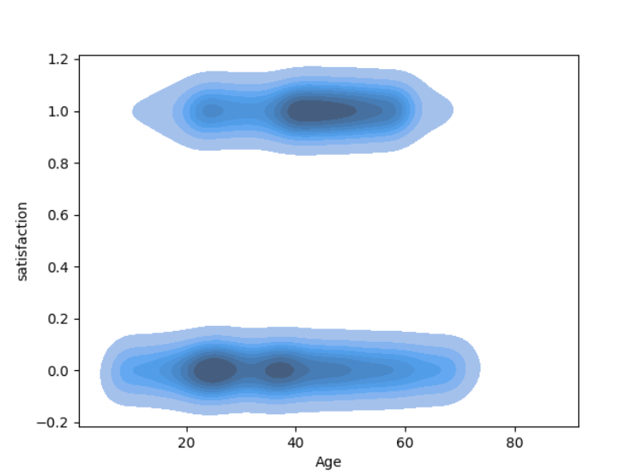
KDE

Slide 23
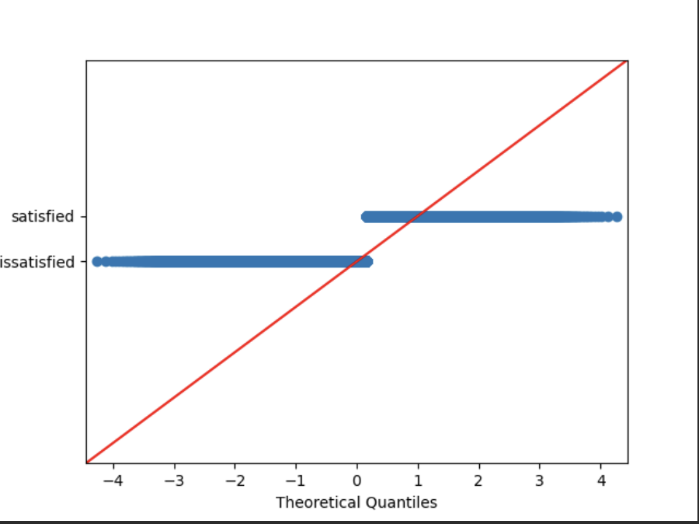
QQ-PLOTS

Slide 24
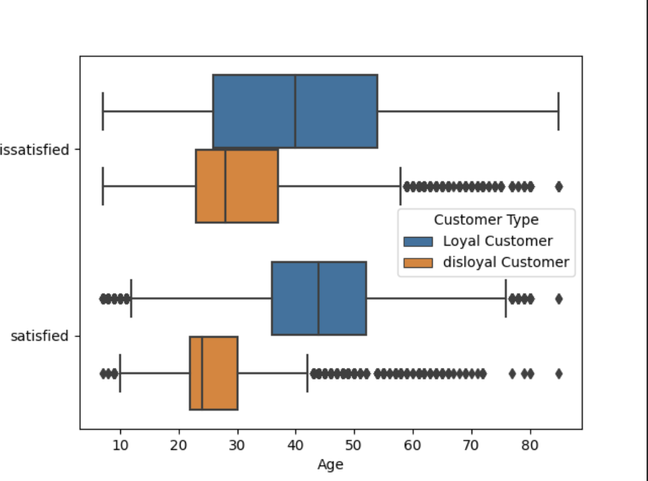
MULTIVARIATE BOX PLOT

Slide 25
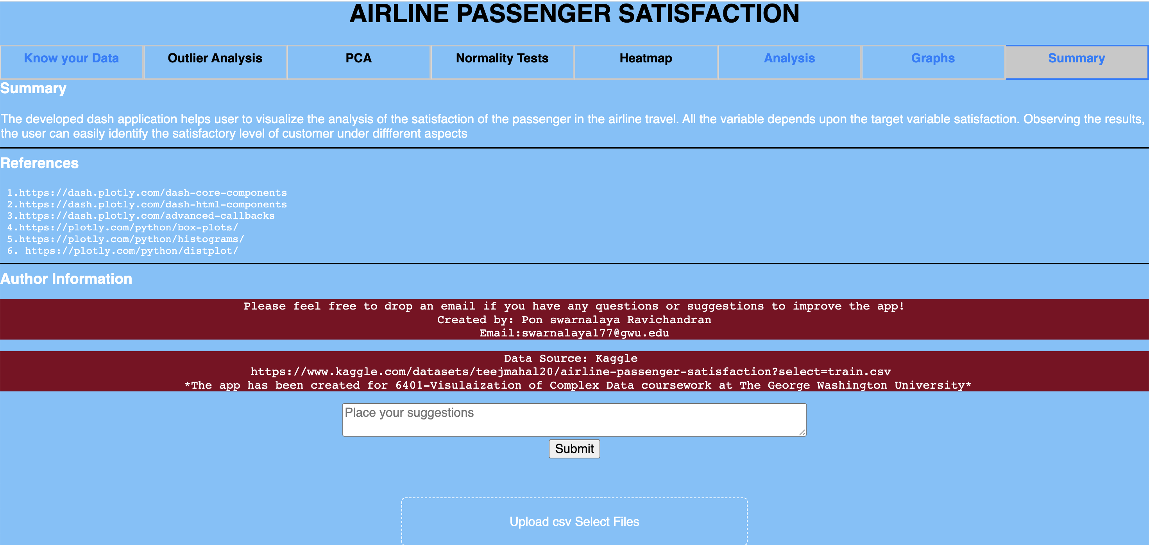
SUMMARY

